Slide 1
Heterogeneous Network Topology Generators
Amer Zaheer

Slide 2

Background: Heterogeneity in Next Generation Networks
  Single Administrative Domains and multiple underlying technologies
  Several Administrative Domains and Several underlying technologies

Slide 3
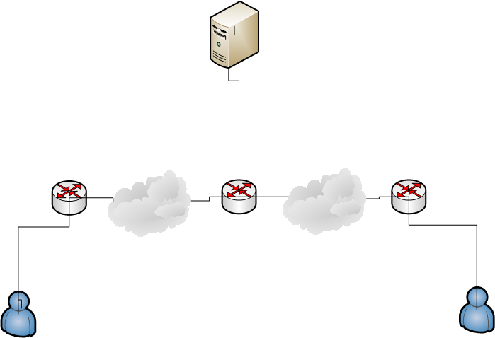
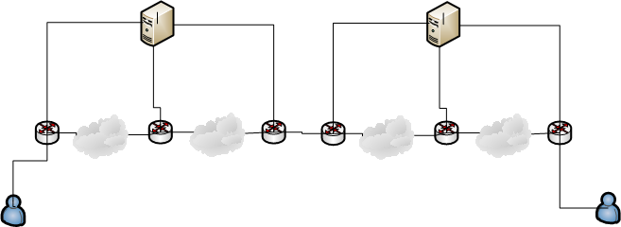
Background: Heterogeneity in Next Generation Networks
Single Administrative Domain
Multiple Administrative Domain

Slide 4
Network Topology Generators
GENSEN
GT-ITM
Tire Topology Generator
Network Topology Generator (NTG)
Inet
BRITE
IGen

Slide 5

Network Topology Generators: GENSEN
GENSEN: A topology generator for Real wireless sensor networks deployement
GENSEN is build in C++ and Free distribution
Partial compatibility with NS-2 because NS-2 does not yet provide a tridimensional scenario
GENSEN will randomly choose the node position
Does not specify different radio propagation in same simulation
Can specify different energy level for WS nodes

Slide 6
Network Topology Generators: GT-ITM
Georgia Tech Internetwork Topology Models(GT-ITM) can be used to create flat random graphs
Compatible with NS-2
Required converter package to covert GT-ITM output to NS-2 format
Support is not available now

Slide 7
Network Topology Generators: Tire Topology Generator
Tire Topology generator allow the random topology generator
Compatible with NS-2 and free distribution
Awk script is required to covert the output of Tire into NS-2 script
Useful for LAN topology generation
Limited details are available

Slide 8

Network Topology Generators: NTG
Network Topology Generator(NTG) allow the creation of random topologies according latest accurate graph models and analysis
NTG possibilities
  Computation of routes between network nodes(Dijkstra, Bellmen-Ford etc)
  Analysis of global connectivity of Mobile Ad hoc networks (MANET and VANET)
  Comparison between single path and multi path algorithms
  And many other features
GUI bases topology generator and simulator
Free software

Slide 9
Network Topology Generators: Inet
Inet, An Autonomous System(AS) level Internet topology generator
Regular updates are available
Compatible with NS-3
Current version is Inet 3.0

Slide 10
Network Topology Generators: BRITE
BRITE support multiple generation models including flat AS, flat routers and hierarchical topologies
Extensible object oriented architecture of BRITE
Compatible with other topology generator like Inet, GT-ITM etc
User friendly GUI interface
Implemented in Java and C++
No longer support is available but questions are entertained through user mailing list
Compatible with NS-2

Slide 11

Network Topology Generators: IGen
IGen is a network topology generator which implements various network design heuristics
IGen does not rely on probabilistic methods
IGen is written in Perl/Tk
GUI based topology generator
Autonomous System(AS) level Internet topology generator

Slide 12
Network Topology Generators: Summery
Name | Licensed | GUI | Specialized for | Compatible
GENSEN | Free | Yes | WSN | NS-2
GT-ITM | Free | No | Interworking | NS-2
Tire Topology Generator | Free | No | Large Internetworks | NS-2
NTG | Free | Yes | Routing, VANET, MANET and Multipath routing algorithms etc
Inet | Free | No | AS level topology generator | NS-3
BRITE | Free | Yes | Flat AS, Flat Router and Hierarchical topologies | NS-2
IGen | Free | Yes | Flat AS, Flat Router and Hierarchical topologies

Slide 13
Thanks

